Slide 1


Green Pace
Security Policy Presentation
Developer: Kerrian Offermann
Notes:
Welcome to the Security Policy Presentation for Green Pace. My name is Kerrian Offermann, and I will be covering standards set in place to keep Green Pace’s data secure.

Slide 2

OVERVIEW: DEFENSE IN DEPTH
In order to protect Green Pace from threats outside the company and vulnerabilities inside, a security policy was drawn up and used as a guide in this presentation.
A security policy is needed because, according to SHRM (2015), human errors are the top causes of security breaches. Knowing this, having a security policy on hand for the entire company to utilize can serve as a starting point for improved security.
This security policy will be used to create multiple layers of defense by teaching how everyone from IT to HR can help to create a more secure Green Pace.
Notes:
Did you know that the top cause of security breaches is human error? Through the creation of security policies such as these, employees within Green Pace can be made aware of threats outside the company as well as the many layers of defense that keep attackers away from sensitive information on a daily basis.

Slide 3
THREATS MATRIX
Likely STR-050-CPP: : Guarantee That Storage for Strings Has Sufficient Space for Character Data and The Null Terminator FIO-030-CPP: Exclude User Input from Format Strings MEM-030-CPP: Do Not Access Freed Memory Issues with strings, inputs, and accessible memory are common causes for bugs. Any errors with these issues should be addressed as soon as possible to avoid future problems. | Priority MSC-041-C: Exclude User Input from Format Strings Any sensitive information hardcoded into the program code needs to be removed as soon as it is found. Any attacker who views the source code will be able to take that information to access the system.
Low priority FIO-051-CPP: Close Files When They Are No Longer Needed ERR-062-CPP: Detect Errors When Converting a String to Number MSC-052-CPP: Value-Returning Functions Must Return a Value from All Exit Paths These threats fall more in line with human errors, and a compiler or error-checking program like CPPCheck will easily point out these issues before deployment. | Unlikely PRE-031-C: Avoid Side Effects in Arguments to Unsafe Macros ERR-051-CPP: Handle All Exceptions ERR-050-CPP: Do Not Abruptly Terminate the Program These errors are not extremely common, but when they happen they are easy to catch. Most programs will not run unless these are fixed, so it will likely not be an issue post-production.
Notes:
In this slide, we have a threats matrix to put into perspective what kind of security threats require immediate attention and how likely Green Pace is to encounter them. The standards that warn of these threats range from likely to unlikely, and priority to low priority.

Slide 4

10 PRINCIPLES
Validate Input Data
ERR-062-CPP: Detect Errors When Converting a String to Number
STR-050-CPP: Guarantee That Storage for Strings Has Sufficient Space for Character Data and The Null Terminator
FIO-030-CPP: Exclude User Input from Format Strings
Heed Compiler Warnings
MSC-052-CPP: Value-Returning Functions Must Return a Value from All Exit Paths
STR-050-CPP: Guarantee That Storage for Strings Has Sufficient Space for Character Data and The Null Terminator
MEM-030-CPP: Do Not Access Freed Memory
PRE-031-C: Avoid Side Effects in Arguments to Unsafe Macros
ERR-050-CPP: Do Not Abruptly Terminate the Program
FIO-051-CPP: Close Files When They Are No Longer Needed
Architect and Design for Security Purposes
ERR-050-CPP: Do Not Abruptly Terminate the Program
Keep It Simple
PRE-031-C: Avoid Side Effects in Arguments to Unsafe Macros
Default Deny
MSC-041-C: Never Hard Code Sensitive Information
Adhere to the Principle of Least Privilege
MSC-041-C: Never Hard Code Sensitive Information
Sanitize Data Sent to Other Systems
FIO-030-CPP: Exclude User Input from Format Strings
Practice Defense in Depths
FIO-030-CPP: Exclude User Input from Format Strings
Use Effective Quality Assurance Techniques
MEM-030-CPP: Do Not Access Freed Memory
ERR-051-CPP: Handle All Exceptions
MSC-041-C: Never Hard Code Sensitive Information
FIO-051-CPP: Close Files When They Are No Longer Needed
Adopt a Secure Coding Standard
MSC-041-C: Never Hard Code Sensitive Information
Notes:
The previous slide introduced us to coding standards, and now we see in this slide the ten principles that they fall into. These principles are essential to approaching all things with security in mind.

Slide 5
CODING STANDARDS
When selecting a priority order for these coding standards, I kept in mind not only what coding errors could lead to security threats but also the severity levels of each code.
For high, I prioritized never hard coding sensitive information, guaranteeing storage for strings, excluding user input from format strings, and stopping access to freed memory since these are issues that could either make breaking into a system easier for an attacker or cause a big enough error to bring the system down.
For medium priorities, I chose closing files that are no longer needed, detecting errors when converting strings to numbers, and ensuring that value-returning functions must return a value. These are parts of the program that rely on producing information based on an input or command; therefore, it is important that they work correctly to avoid bugs in the system that could hinder security.
Finally, for low priority coding standards, I selected avoiding side effects in macros, handling all exceptions, and not abruptly terminating a program. While these coding standards may be lower than the others, it is still imperative to the system that they work correctly. Macros, exceptions, and the proper closing of programs assist in helping the system run smoothly. Overlooking these can also lead to bugs later on.
MSC-041-C: High
STR-050-CPP: High
FIO-030-CPP: High
MEM-030-CPP: High
FIO-051-CPP: Medium
ERR-062-CPP: Medium
MSC-052-CPP: Medium
PRE-031-C: Low
ERR-051-CPP: Low
ERR-050-CPP: Low
Notes:
Each coding standard provides us with things we must keep an eye out for when creating software. The severity level of high, medium, and low tells us which things we should always give immediate attention to and which things we should keep an eye out for to prevent gaps in our security.

Slide 6
ENCRYPTION POLICIES
Encryption At Rest: All data that lies in storage, hard drive, a disc, etc. must have restrictions in place that limit access. Those with the required privilege will have the necessary keys to bypass the encryption while those who do not will be denied access. It is recommended that a log be created of everyone who attempts to access encrypted files that is not a requirement of their position, such as someone who is not in IT attempting to access an encrypted IT files with private information.
Encryption In Flight: Any data sent from one network to another should be encrypted on both ends. Methods such as creating certificates can be used to ensure that the person receiving an encrypted file has the right verification in place to accept it. Received data should also be “scrubbed” with virus and malware programs to ensure no malicious programs were sent with the requested files. As for files being sent, they should be encrypted so the person on the other end must have the required key in order to access it. If a file is somehow taken mid-flight between networks, the data should be scrambled so those responsible for stealing the file cannot make sense of the data inside.
Encryption In Use: When a file is being accessed/read, there should first and foremost be a log in place to record who opened the file and what was done to the file while it was in their care. Beyond logging activity, verification should be put in place to ensure that the person reading the file is someone who is authorized to do so. Any temporary files created from an opened file should be scrambled and require an encryption key in the same fashion that the file itself does so no one can read the contents of the file while it is being opened. It is recommended that highly sensitive files or programs with access to highly sensitive information be closed after a period of inactivity.
Notes:
There are also encryption policies that cover how private information should be protected while they are not being used (or at rest), when they are being sent (or in flight) and when they are being accessed (or in use). Each type requires different types of security threats we should look out for.

Slide 7
TRIPLE-A POLICIES
Authentication: The act of requiring every user to have a verified username and password created by an admin is a policy put into place to promote authentication. All who access the system will be expected to have their established login—no guest accounts allowed. This is because each account will have privileges set in place based on the user’s role in the company, and this will determine what they can(not) do while in the system’s database.
Authorization: The aforementioned privileges in the authentication process are also a part of the authorization process. Based on the privileges granted, users will be granted the ability to perform certain actions and access certain files within their “level”. Only administrators will have the ability to perform actions within the system that involve adding, removing, or updating specific items or users to the database. It is good practice to grant users the least amount of privileges necessary to perform their jobs and nothing more.
Accounting: The accounting policy is essentially overlooking the authentication and authorization process by tracking what occurs within the system. This includes searching for unusual activities in various logs that involve the behaviors of different users and if they are interacting with the system in a way that is acceptable. For example, accounting can be searching logs to see who attempted to access the financial information of employees in the HR database, and pinpointing suspicious users who attempted to access these files despite it being completely outside of their department or expected level of privileges. Actions like these can stop malicious attackers in the middle of their attempts to hijack a system rather than wait until it is too late.
Notes:
The Triple A framework—or Authentication, Authorization, and Accounting—also works to protect security by asking, “Who is trying to access our system?” “What are they allowed to access?”, and “What are they doing while in our system?”

Slide 8
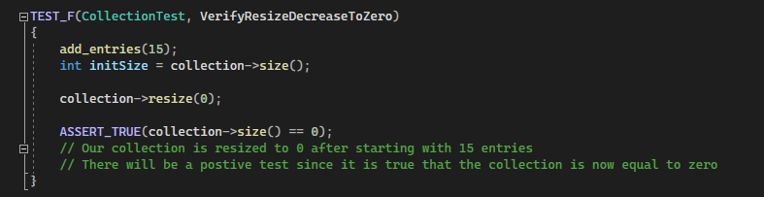
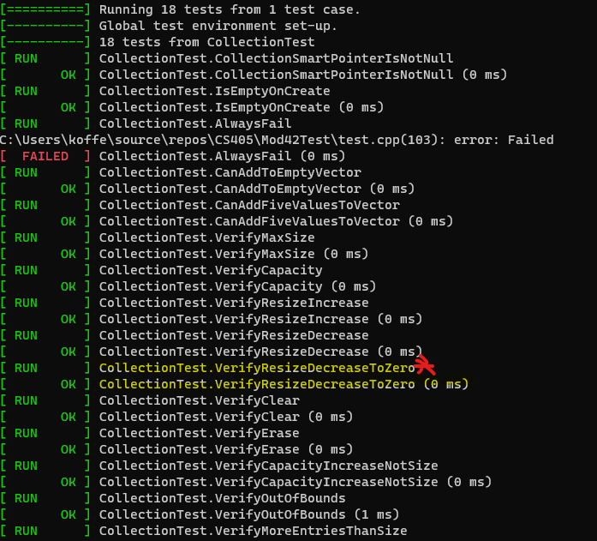
Unit Test: Confirm Vector Storage Size
Guaranteeing the storage size of a vector, array, etc. accepting strings is one of the high-severity coding standards we have.
In this unit test, we are testing if a vector with 15 entries will successfully be reduced to zero once the storage size is changed to zero. In essence, we are testing if resizing the collection will also clear any values assigned to the memory within that vector.
ASSERT_TRUE was used to check if the size is actually zero. If it was not then the test would have returned as a failure.
Notes:
Now that we discussed some security threats inside and outside the company, some unit tests were performed to ensure that the code is behaving as it should in order to prevent bugs or gaps in security later on. In this example, we are testing one of our coding standards to see if strings are being stored in vectors, arrays, containers, etc. that have the proper storage size.

Slide 9
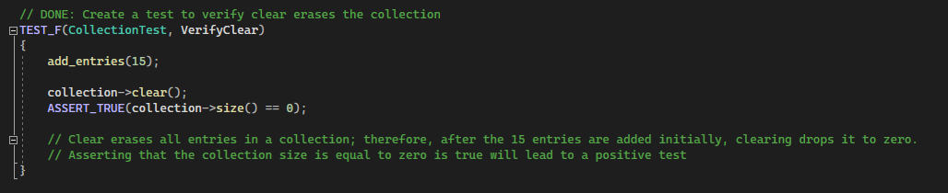
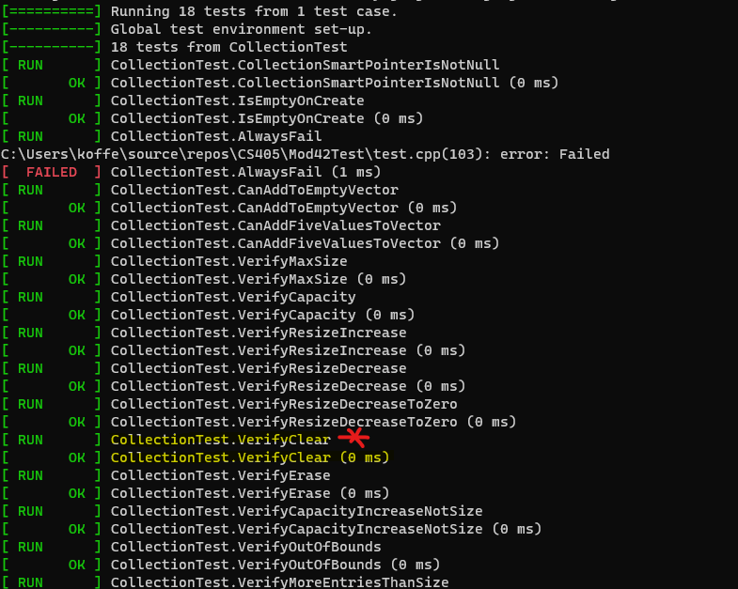
Unit Test: Confirm Storage is Clear
Adding entries to a vector assumed to be clear can lead to bugs when values are attempting to assign themselves to spaces in the memory that are not available.
In this unit test, we are testing if a vector that was once filled with 15 entries has been cleared of all entries. This means that if 15 new entries were added after this clear then it would not lead to problems since all previous values were cleared.
ASSERT_TRUE was used to check if the collection->clear() function performed its task correctly and erased the values that were once inside the vector.
Notes:
A unit test was also done to see if there is sufficient space for the storage of character data and strings by testing if clearing a vector of old data works correctly so new data can be entered without issue.

Slide 10
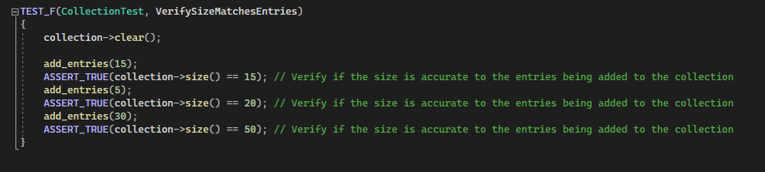
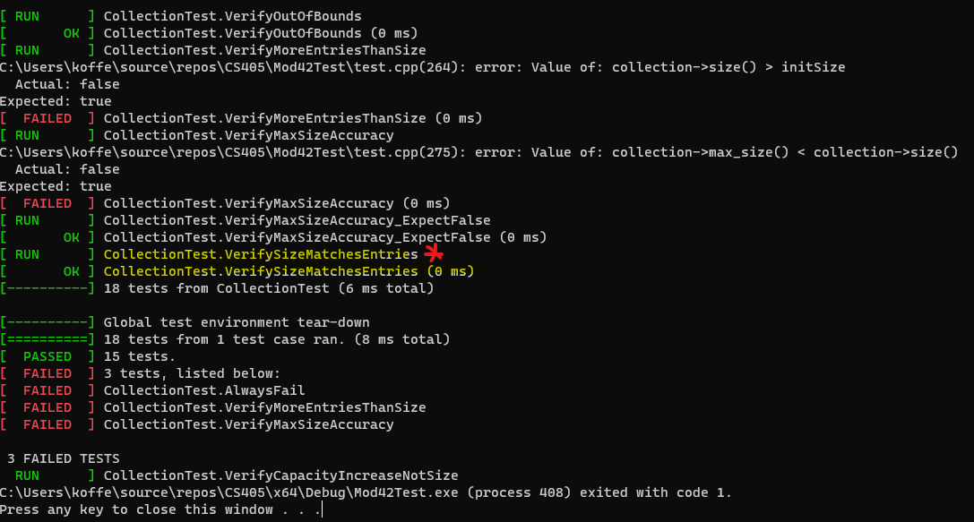
Unit Test: Confirm Storage Size Matches Entries
For this unit test, we are ensuring that when entries are added to the vector, the vector resizes according to the amount of entries added.
Each time new entries are added, the unit test will check the new size of the vector. This test will help to make sure that new values added to the vector are not out of bounds or that the values are not being stored incorrectly.
When the vector’s size increases upon entries being added, ASSERT_TRUE examines if it is equal to the correct total size, and that values are not being erased or overwritten.
Notes:
For this unit test, we are verifying that each time entries are added to storage that storage accommodates for it and increases its size accordingly. Entries are added at various intervals and then the size is tested for accuracy.

Slide 11
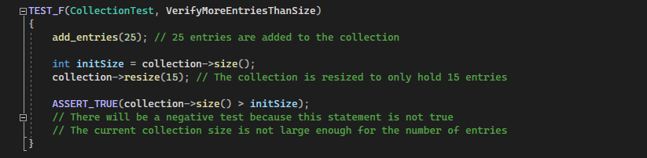
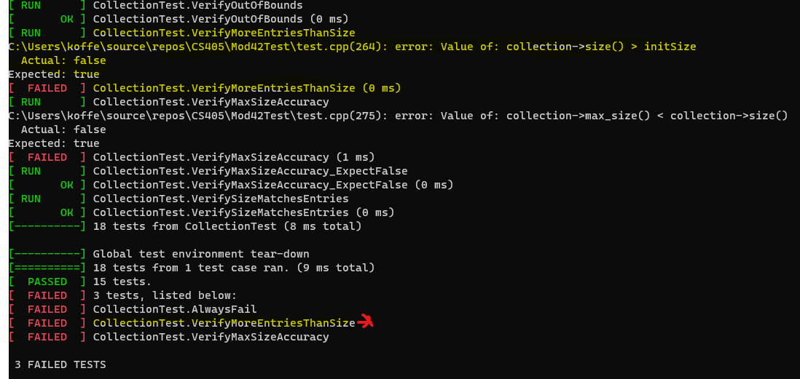
Unit Test: Confirm Failure When Entries Are More Than Size
For this unit test, the intention was to get a failure. Tests like these are not much different from positive ones. It just makes sure that something that should fail is actually failing.
In this instance, we are attempting to add 25 entries to a vector that only accepts 15 entries. This should flag in the test as a problem.
During the test, we are asking via ASSERT_TRUE if the vector is larger enough to handle the amount of entries being added. It is not, so the test returns as a failure.
Notes:
Finally, we ran a negative test to force a failed unit test. Basically, we are testing what will happen when too many entries are added to a vector that cannot store it, and ensuring that there are measures in place to flag when something is wrong.

Slide 12

AUTOMATION SUMMARY
Architect and Design for Security Policies: The planning stage is the best place to begin building a system with security in mind.
Use Effective Quality Assurance Techniques: Take the lessons learned to establish more quality coding and security techniques
Practice Defense in Depths: While establishing security settings, build multiple barriers of security and then test them during penetration tests.
Adhere to the Principle of Least Privilege: Ensure users are only given privileges necessary to do their jobs and watch logs for suspicious activities.
Sanitize Data Sent to Other Systems: “Scrub” data clean when sending and receiving files, and act accordingly if any files are still corrupted with possible malicious code.
Heed Compiler Warnings: Compilers can be used during design and build to test if the code has any problems.
Keep It Simple: The time to ensure simplicity in the code is whilst writing the code itself.
Validate Input Data: This is where inputs can be tested to see if they allow threats into the system.
Default Deny: Before deploying and while testing security, ensure non-authorized persons cannot access the systems
Adopt a Secure Coding Standard: Add or update policies based on the response and actions used because of an attack/compromise; extract lessons from the experience to update/add coding standards.
Notes:
After examining several tests and looking back on the policies created, it was determined which policies could be added to the automation process and what position they would work best in. The diagram provides a brief overview.

Slide 13
TOOLS
The DevSecOps—or Development, Security, and Operations—pipeline is a means of using automation to create secure systems, programs, databases, etc. The goal of the DevSecOps pipeline is to add security to every phase of a software’s development cycle instead of leaving it to security alone.
When testing the security of Green Pace, external tools were used such as Visual Studio 2022, CPPCheck, GoogleTest, and Avast One (optional).
Visual Studio 2022 was the tool used to write, compile, and deploy various security tests. During testing, VS was kept up-to-date with its updates and dependencies to avoid issues outside of the intentional ones being tested. In the automation process, Visual Studio would be utilized in the pre-production phases of the diagram and possibly production if some additional codes need to be added for security reasons.
CPPCheck was used as a supplement of sorts to the Visual Studio 2022 compiler. With CPPCheck, we were able to pick up additional errors that the VS compiler did not pick up and receive more detailed explanations to the problems found in the code we tested. CPPCheck would be best used between the “Verify and Test” and “Transition and Health Check”.
GoogleTest was used during the various unit tests done to assert (true/false) different conditions to be tested, and to expect throws. It was used within Visual Studio. When looking at the automation diagram, GoogleTest would work best during the “Verify and Test” stage or during the “Transition and Health” stage where penetration tests are regularly performed to test the security standards already in place.
Notes:
During the process of researching, testing, and exploring ways to improve security, tools like Visual Studio 2022, CPPCheck, and GoogleTest were used. These tools can also be added to company resources as newer ways to improve security against threats that come our way.

Slide 14

RISKS AND BENEFITS
First and foremost, there is no perfect security; therefore, there will always be risks. Especially since hackers find new ways to infiltrate systems constantly. Still, that does not imply that improving security on a regular basis yields no purpose.
One strategy that needs to be implemented immediately is an update schedule. Putting off updates means putting off important barriers created against the new threats that spring up constantly.
It is preferable to act now over waiting because there are constant updates and threats to look out for. A risk to this strategy is not having the time to truly educate one’s self on these new threats, updates, patches, definitions, etc. before acting on them. However, the alternative is to put these things off and risk being exposed to new threats while learning about old ones. Unfortunately, things move rapidly in the world of technology. Security is no different. Even if there is not an ample amount of time to get caught up on the major moves being made, there should be a sense of urgency when it comes to keeping security current.
In order to be kept aware of new changes in the security world of technology, there are free sources such as OWASP, Red Hat, and NIST that provide a constant stream of blogs, updated databases, and such to keep programmers in the know about threats and vulnerabilities that are gaining attention on the internet.
This Photo by Unknown Author is licensed under CC BY-SA-NC
Notes:
With every new process comes risks, but adding these major changes to our security process can lead to unexpected improvements. One major change is to add updates and educating every Green Pace employee to a part of the security policy, and to perform these tasks as frequently as possible.

Slide 15

RECOMMENDATIONS
Training: When Green Pace is faced with a security threat, there should be a point after the “Respond” phase where every department is briefed on what this threat is, how it likely ended up being exposed to the database, and what can be done to prevent such a problem from reoccurring. It is true that DevSecOps are key to creating a solid automation process; however, all it takes is one person in an entirely different department to click a bad link in a spam email for major damage to be done to the database. It is recommended that employees are trained regularly through the company intranet and/or Green Pace implements a system where false spam emails are sent to employees to see how many report it as spam/phish versus how many open it or do nothing at all. The goal is not to punish employees for not understanding security threats, but to locate gaps in their understanding so they can be caught up with their peers in terms of understanding security.
Increased Unit Testing: Unit testing is a valuable method of anticipating potential bugs before they occur in a live environment. During the pre-production process, there should be unit testing done during the design process and then again between the “Build” and “Verify and Test” part of the automation process. Any security concerns should be tested during the unit test just to make sure that the program reacts as it should to possible errors being done.
Update Regularly: Updating security software, definitions, dependencies, etc. is something that should happen during pre-production (preferably before and after designing a program) and again in production (during Monitor and Detect phase as well as after Respond). Sources such as OWASP and the National Institute of Standards and Technology (NIST)’s national vulnerability database offer a constant stream of updates about threats, their severity levels, and even how to handle them if they become a problem for security.
This Photo by Unknown Author is licensed under CC BY-SA-NC
Notes:
Green Pace has already developed a lot in terms of having a plan set in place for security. However, there are a few recommendations after establishing some security policies. First, training. Everyone should be trained on the threats and actions to take. There should also be an increase in unit testing to ensure that things are doing what they should be doing. Finally, update throughout several stages of the automation process and do so regularly.

Slide 16

CONCLUSIONS
As mentioned at the start, human errors are the top reason for security breaches. This, of course, is not something done intentionally. It is simply a result of not understanding how a seemingly innocent action can lead to security threats. The best way to tackle this issue to educate not only those team members who are a part of DevSecOps, but also team members who interact with various networks on a daily basis where malicious programs can be transferred from system to system with ease.
The coding standards provided examine everything from user inputs to values within a program to ensure that weaknesses are not created in the database by mistake. There are also encryption policies for files at rest, in flight, and in use. When teamed with the Triple A framework, actions within the company can be made secure while the security team also works on an automation process to tackle outside threats.
DevSecOps is encouraged to introduce regular security updates to their automation process as well as regular work routine. No security system should ever run with definitions and dependencies that are months or even years old. Outside sources and tools are available to keep the system current at all times.
This Photo by Unknown Author is licensed under CC BY
Notes:
Regardless of the cause for a security breach, being educated on different threats, skills, techniques, and tools can encourage a culture of protecting important data in the Green Pace workplace. No effort is unimportant. Always remember to protect the systems that keeps Green Pace running, and to never lose the desire to learn more ways to keep them safe.

Slide 17
REFERENCES
Maurer, R. (2015, April 13). Human error cited as top cause of data breaches. SHRM. https://www.shrm.org/resourcesandtools/hr-topics/risk-management/pages/human-error-top-cause-data-breaches.aspx
Offermann, K. (2023, April 6). Project one security policy. SNHU.
Dhote, C., Vitucci, C. (2015, April 13). Developing a devsecops pipeline: 8 factors to consider. Qentelli. https://www.qentelli.com/thought-leadership/insights/devsecops-pipeline-factors
National Institute of Standards and Technology. (n.d.) National vulnerability database. NIST. https://nvd.nist.gov/
Open Worldwide Application Security Project. (n.d.) OWASP dependency-track. OWASP. https://owasp.org/www-project-dependency-track/
Notes:
Thank you for your time!

